Slide 1
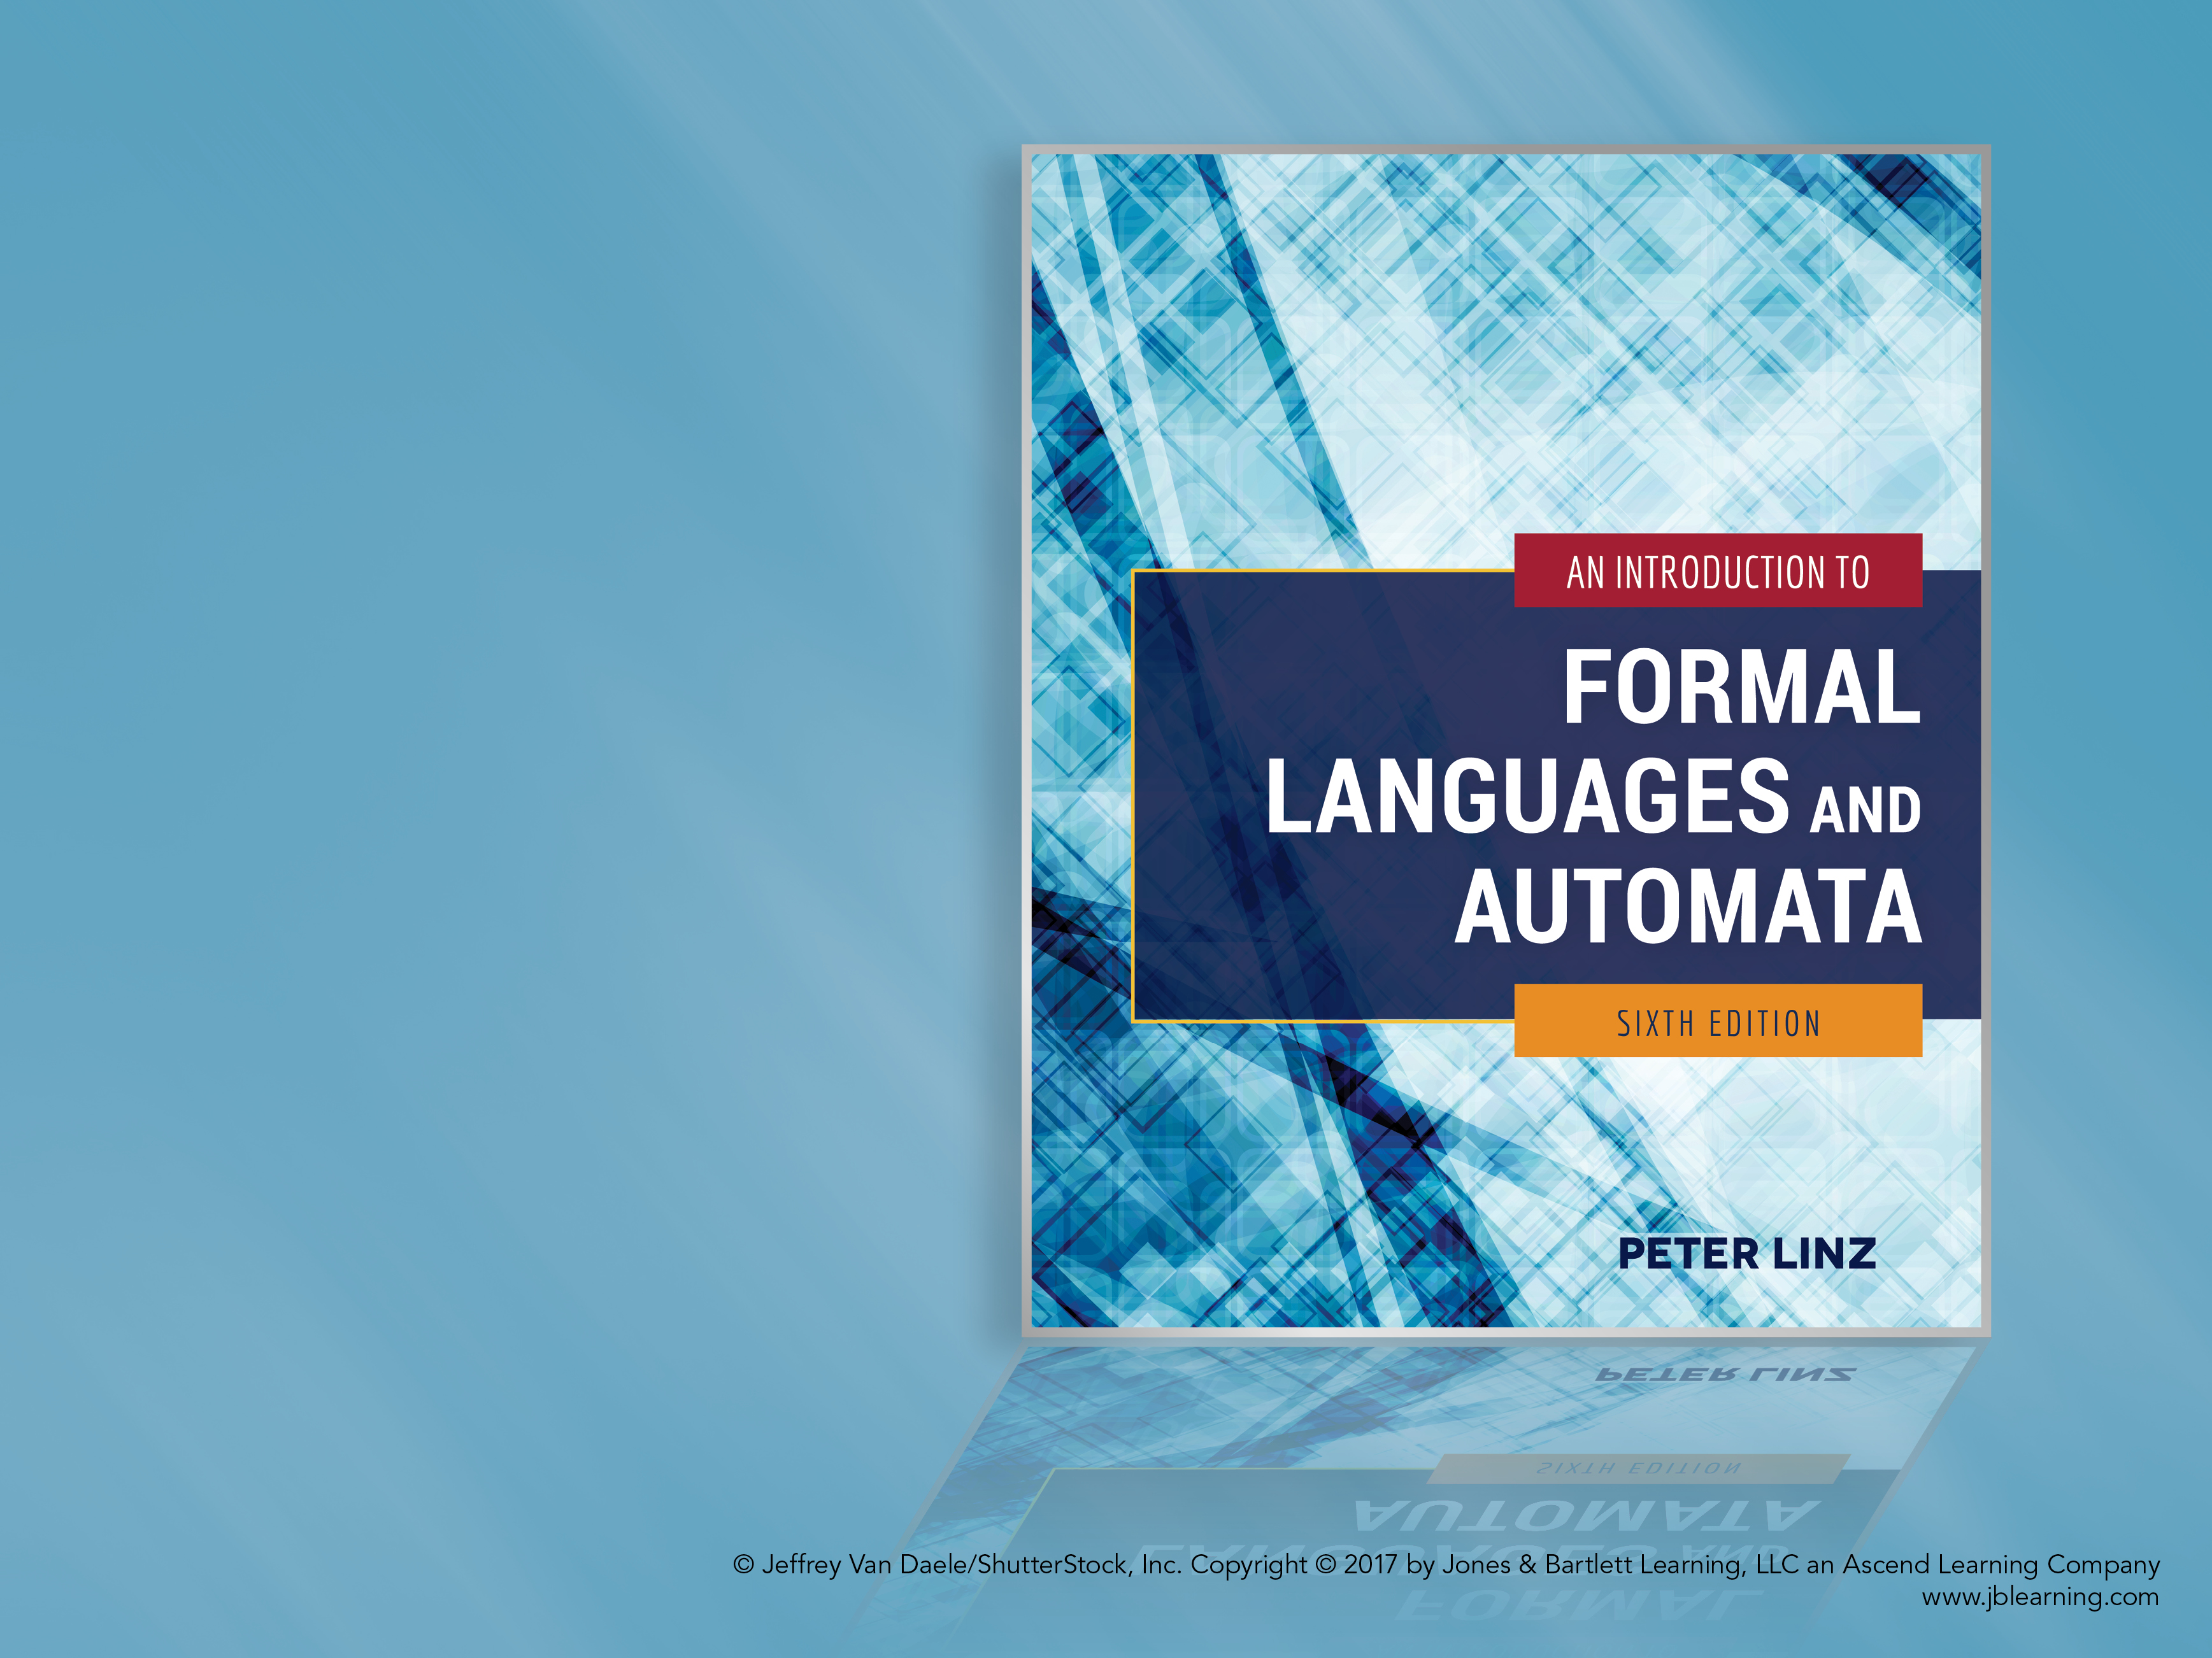
Chapter 13
OTHER MODELS OF COMPUTATION

Slide 2

Learning Objectives At the conclusion of the chapter, the student will be able to:
Define the basic functions and the operations used to build more complex functions
Construct arithmetic operations using basic functions and operations
Given a simple function, show that it is primitive recursive
Evaluate Ackermann’s function for sample arguments
Define the concept of μ-recursive functions
Describe the restrictions and characteristics of Post systems, matrix grammars, Markov algorithms, and L-systems
Derive sample sentences generated by Post systems, matrix grammars, Markov algorithms, and L-systems

Slide 3
Basic Functions
It is important to specify a formal notation for the definition of mathematical functions
In all cases, the domain is either I (the set of all nonnegative integers) or the Cartesian product I x I, while the range is I
The basic functions are
The zero function z(x) = 0, for all x ∈ I
The successor function s(x) = x + 1, for all x ∈ I
The projector functions
p_{k} (x₁, x₂) = x_{k}, for k = 1, 2

Slide 4
Building Complex Functions
There are two ways of building complex functions from the primitive functions: composition and primitive recursion
Composition: given defined functions g₁, g₂, and h,
f (x, y) = h (g₁(x, y), g₂(x, y))
Primitive recursion: given defined functions g₁, g₂, and h,
f (x, 0) = g₁(x)
f (x, y + 1) = h (g₂(x, y), f(x, y))

Slide 5
Constructing Arithmetic Operations
Examples 13.1 and 13.2 show that arithmetic operations can be constructed from the basic functions
Addition of integers x and y:
add (x, 0) = x
add (x, y + 1) = add (x, y) + 1
Multiplication of integers x and y:
mult (x, 0) = x
mult (x, y + 1) = add (x, mult(x, y))

Slide 6
Primitive Recursive Functions
A function is primitive recursive if and only if it can be constructed from the basic functions z, s, p_{k}, as well as composition and primitive recursion
While most common functions are primitive recursive, there are functions from I to I which are not primitive recursive, as established by Theorem 13.1
Theorem 13.2 goes further: there are total, computable functions from I to I which are not primitive recursive
The nonconstructive proofs that confirm these results are based on the concept of diagonalization

Slide 7
Ackermann’s Function
An example of a total computable function from I to I which is not primitive recursive is known as Ackermann’s function
Ackermann’s function is defined by
A(0, y) = y + 1
A(x, 0) = A(x – 1, 1)
A(x, y + 1) = A(x – 1, A(x, y))
Ackermann’s function grows rapidly, as shown below
A(3, 1) = A(2, A(3, 0)))
= A(2, A(2, 1)))
= A(2, A(1, A(2, 0)))
= A(2, A(1, A(1, 1)))
= A(2, A(1, A(0, A(1, 0))))
= A(2, A(1, A(0, A(0, 1))))
= …

Slide 8
μ Recursive Functions
Recursive functions can be extended by the introduction of the μ or minimalization operator
Assuming that g is a total function, the minimalization operator is defined by
μy(g(x, y)) = smallest y such that g(x, y) is 0
As shown in Example 13.4, if g(x, y) = x + y – 3,
μy(g(x, y)) = 3 – x, for x ≤ 3
= undefined, for x > 3
A function is μ-recursive if it can be constructed from the basic functions by a sequence of applications of the μ-operator as well as composition and primitive recursion
By Theorem 13.2, a function is μ-recursive if and only if it is computable

Slide 9
Post Systems
A Post system is similar to an unrestricted grammar, but there are significant restrictions in the way the productions are applied
A Post system II is defined by
A finite set of constants C, consisting of two disjoint sets: C_{N}, called the nonterminal constants, and C_{T}, called the terminal constants
A finite set of variables V
A finite set from C* called the axioms
A finite set of productions P
Each production is of the form
x₁V₁x₂ … V_{n}x_{n+1} → y₁W₁y₂ … W_{m}y_{m+1}
where x_{i}, y_{i} ∈ C*, and any variable V_{i} can appear at most once on the left, and each variable W_{i} on the right must also appear on the left

Slide 10
The Language Generated by a Post System
The language generated by a Post system II = (C, V, A, P) is the set of all strings w in C_{T}* generated by applying a sequence of productions that start with some w₀ in A
As shown in Example 13.5, consider the Post system with C_{T} = {a, b}, C_{N} = ∅, V = { V₁ }, A = { λ },
and production V₁ → aV₁b
This system allows the derivation
λ ⇒ ab ⇒ aabb
It can be concluded that the language generated is {a^{n}b^{n}: n ≥ 0}
As stated in Theorem 13.6, a language L is recursively enumerable if and only if there exists some Post system that generates L

Slide 11
A Post System for Generating Identities of Integer Additions
As shown in Example 13.6, the Post system below is designed to generate the set of all identities of integer additions using unary notation
C_{T} = { 1, +, = },
C_{N} = ∅,
V = { V₁, V₂, V₃ },
A = { 1 + 1 = 11 },
with productions
V₁ + V₂ = V₃ → V₁1 + V₂ = V₃1
V₁ + V₂ = V₃ → V₁ + V₂1 = V₃1
This system allows the derivation
1 + 1 = 11 ⇒ 11 + 1 = 111 ⇒ 11 + 11 = 1111

Slide 12
Matrix Grammars
The grammars previously studied are known as phrase-structure grammars
Matrix grammars differ from phrase-structure grammars in how the productions can be applied
For matrix grammars, the set of productions consists of subsets P₁, P₂, …, P_{n}, each of which is an ordered sequence of the form
x₁ → y₁, x₂ → y₂, …
Whenever the first production of some set P_{i} is applied, we must apply the second one, then the third one, etc.
The first production in the set P_{i} can only be applied if all other productions in this set can also be applied

Slide 13
Languages Generated by Matrix Grammars
As shown in Example 13.7, consider the matrix grammar
P₁: S → S₁S₂
P₂: S₁ → aS₁, S₂ → bS₂c
P₃: S₁ → λ, S₂ → λ
This system allows the derivation
S ⇒ S₁S₂ ⇒ aS₁bS₂c ⇒ aaS₁bbS₂cc ⇒ aabbcc
The language generated is {a^{n}b^{n}c^{n}: n ≥ 0}
Phrase-structure grammars are a special case of matrix grammars in which each P_{i} contains exactly one production
Although they are equivalent in power to phrase-structure grammars, matrix grammar allow for simpler solutions when generating complex languages

Slide 14
Markov Algorithms
A Markov algorithm is a system whose productions of the form x → y are considered ordered:
In a derivation, the first applicable production must be used, and
The leftmost occurrence of the substring x must be replaced by y
Some of the productions may be identified as terminal productions (followed by a period)
A derivation starts with some string w in Σ and continues either
until a terminal production is used, or
until there are no applicable productions
In a sense, Markov algorithms are grammars working backward: a string of terminals w is accepted if a derivation that starts with w generates the empty string

Slide 15
Sample Markov Algorithms
As shown in Example 13.8, consider the Markov algorithm with Σ = T = { a, b }, and productions
ab → λ,
ba → λ.
Since every step in the derivation eliminates the substring ab or ba, the language generated consists of strings in Σ* with an equal number of a’s and b’s
As shown in Example 13.9, consider the Markov algorithm with Σ = T = { a, b }, and productions
ab → S,
aSb → S,
S → λ.
A sample derivation is: aabb ⇒ aSb ⇒ S ⇒ λ
It can be shown that the language generated is {a^{n}b^{n}: n ≥ 0}
As stated in Theorem 13.7, a language L is recursively enumerable if and only if there exists a Markov algorithm that generates L

Slide 16
L-Systems
L-systems are parallel rewriting systems used to model the growth pattern of certain organisms
In an L-system, every symbol must be rewritten at each step of a derivation
As shown in Example 13.10, consider the L-system with Σ = { a } and a single production a → aa
A sample derivation is: a ⇒ aa ⇒ aaaa ⇒ aaaaaaaa
It is not difficult to conclude that the language generated is { a^{m} : m = 2^{n}, n ≥ 0 }
An extension of the L-system definition produces a mechanism that servers as another general model of computation

